Slide 1
MSA Payment Term Mastering
Updated August 2024

Slide 2
MSA Payment Term Mastering makes seller processes easier
MSA Payment Term metadata stored in MSD
MSA Payment Terms automatically populated on Quotes
If Agreement Payment Terms <= MSA Payment Terms, Deal Desk approval is not required*
*Payment terms <= 30 days will continue to not require approval. Approval could still be required based on the entries in other fields. Full guide to Deal Desk approval here
Note: MSA payment terms field is not available on Quotes created before January 15th, 2024; automation is not available on these Quotes

Slide 3
When to update MSA Payment term in MSD
When: Use the process below under the following situations:
There is either a new MSA or a renewal of an existing MSA with a payment term greater than 30 days net (NM01)
The payment term of an existing MSA is changing because a contractual condition has been met (e.g., once minimum spend of USD X has been reached, new payment term is Y days net).
How special cases will be treated
When a client has varying payment terms for different services (e.g., 90 days for RMS and 45 days for BASES), We will enter only the shortest term in MSD. All cases under these MSA which have a longer contracted payment term will have to use a DDAR** to obtain approval.
In case a client enters into a new MSA, but there is an existing MSA which is still effective (not expired, not replaced or preceded by the new MSA) we will retain the lowest payment term in the system, because we cannot have two terms in this process.
*Press ctr + click to open the blue text links and be redirected to additional content. **Deal Desk Approval Request, MSA (Master Service Agreement), MSD (Microsoft Dynamics, this is the CRM tool of NIQ)

Slide 4
How to request a change to MSA payment terms metadata
Examples of changes: client was not included in initial data upload, new MSA, renewed/amended MSA, client spend tier triggered payment term change
Seller fills in this form, attaches MSA within form
Deal Desk reviews submission and confirms accuracy
Deal Desk coordinates change in MSD
Logistical details:
Santiago Bula oversees this process
Deal Desk coordinates bulk data change with MSD admin team, if needed
CTRL + Click on this link to open the form

Slide 5
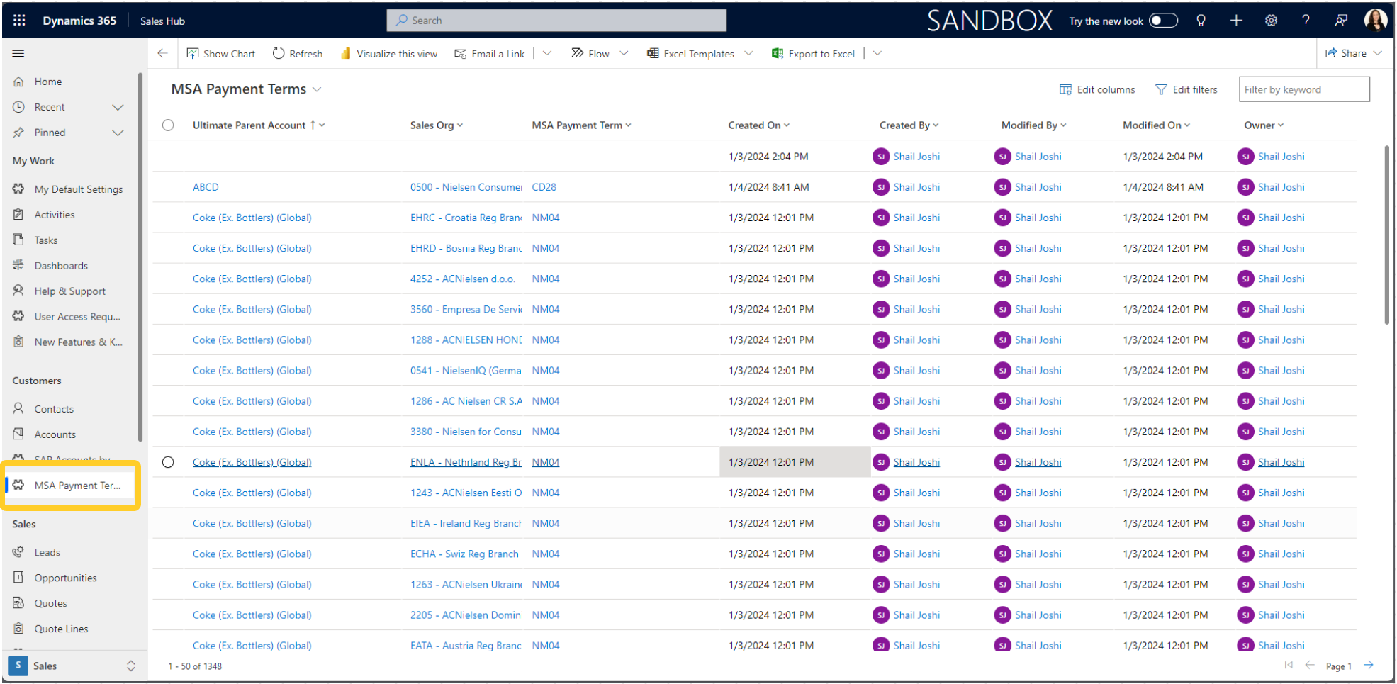
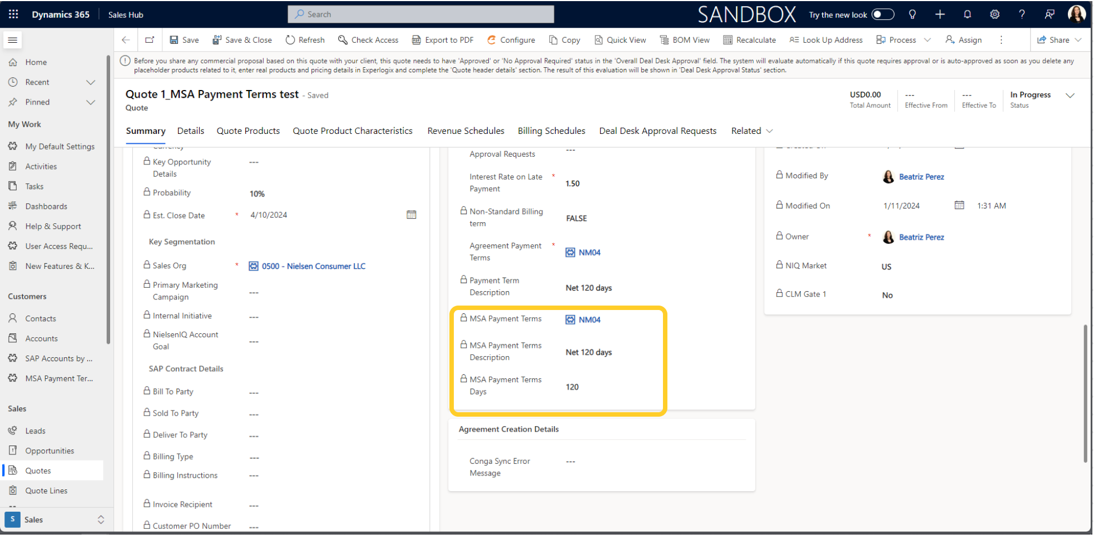
How to see MSA payment terms metadata in MSD
On the left side Menu, under Customers there is a new entity called "MSA Payment Terms".
On the Opportunity, user will be able to see the applicable MSA Payment Terms on the Quote page.

Slide 6
After a metadata change is made
Updating quotes
MSA payment terms populate on quote upon creation
Any quotes created after payment terms update will include updated terms
If changes are needed on quotes created before payment terms update, user will need to manually update
Updating approval required
“Recalculation” of approval requirement should occur automatically based on update to MSA payment terms on parent account
If this does not happen, you can force MSD to recalculate – tip here
Remember, approval could still be required based on the entries in other fields. Full guide to Deal Desk approval here

Slide 7
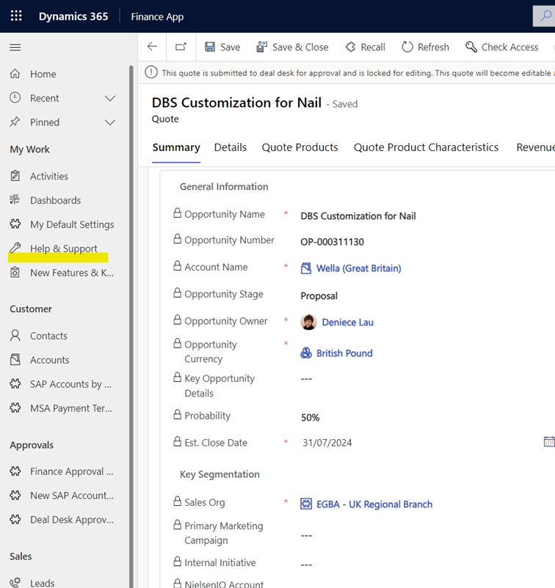
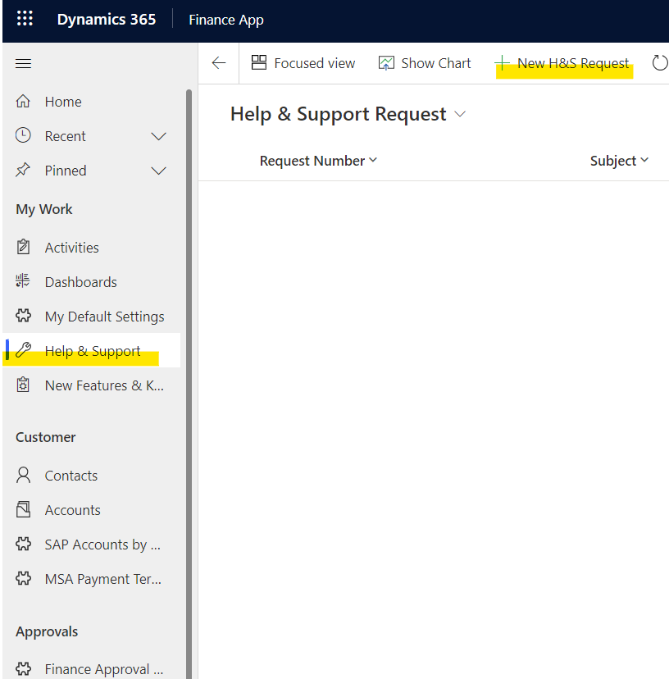
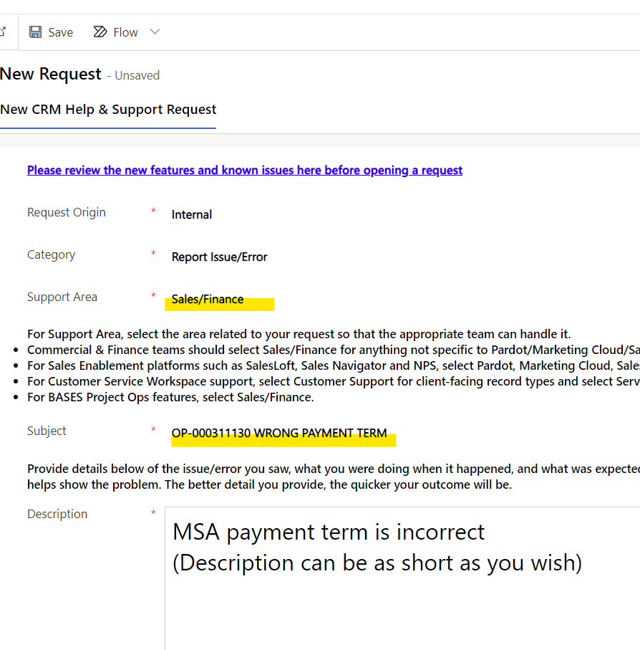
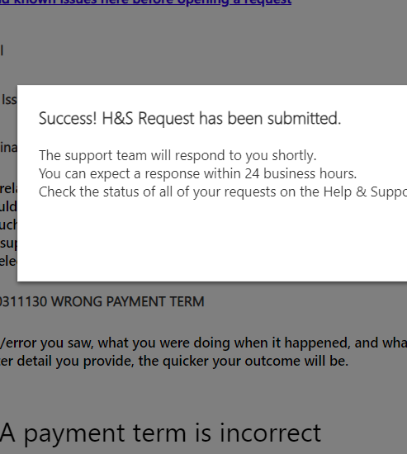
The MSA payment term description is correct in other OPs, but not in this one.
If you notice that a specific OP does not have the correct payment term and the rest of them do, please initiate a Help & Support request.
1. Click on Help & Support
2. Click on ‘New H&S Req..’
3. Choose ‘Sales/Finance’
4. Success! Pop-up window
After identifying the OP that needs a correction go to the left bar of your request (LINK)
Your request will be reviewed within 24 hours
Make sure that the Support area is ‘Sales/Finance’ and you have added the OP number
Once you have clicked on Save, you should see a message like this one.
DISCLAIMER: This tutorial was created to explain how to fix the technical or admin issues in MSD. If you wish to modify commercial terms or look for an exception, you must follow the process with the deal desk.
A Help & Support request does not substitute a DDAR..

